Slide 1
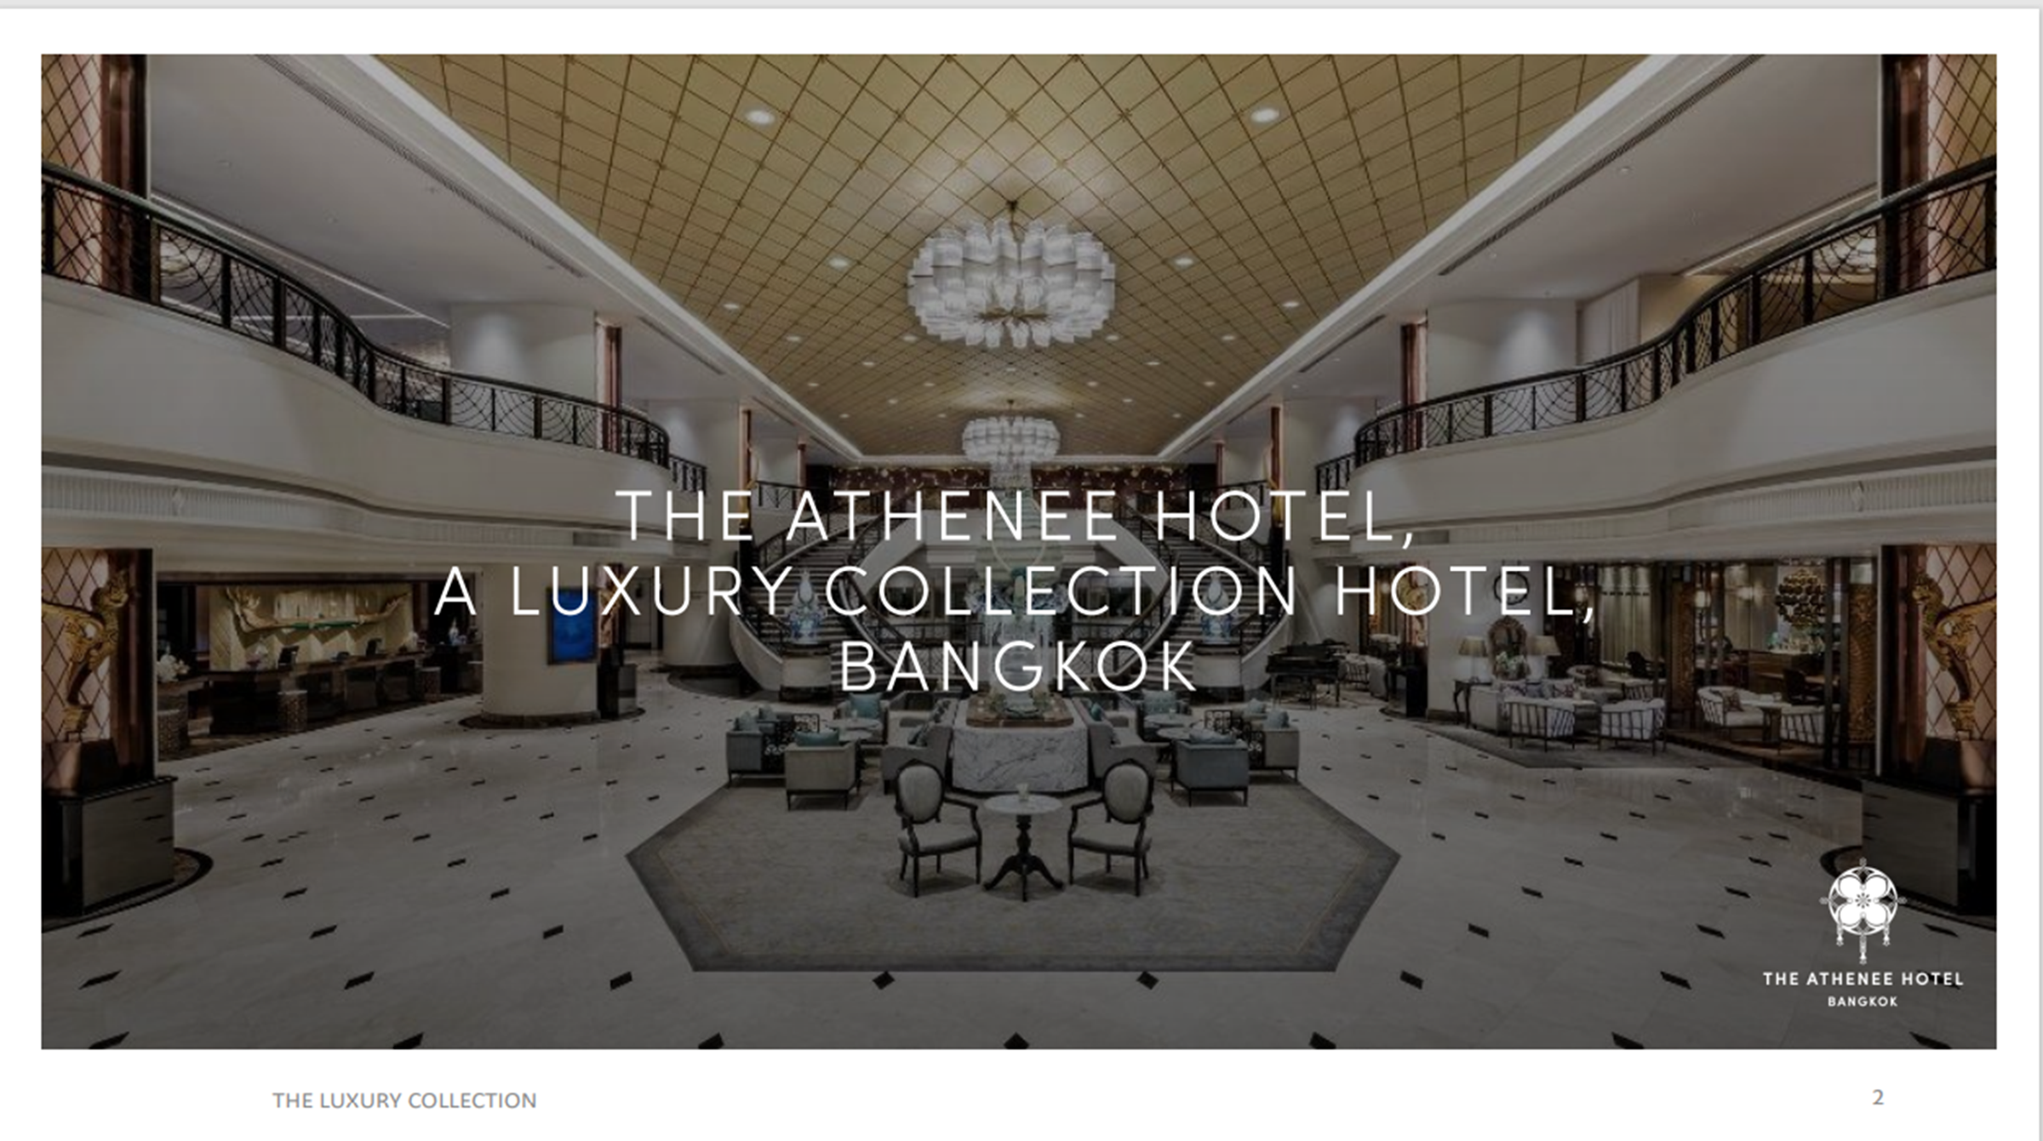
Evacuation Plan

Slide 2
In case of emergency, the bell alarm will be rang and public address will be announced to evacuate.
When the guest hear the bell alarm and announcement, please evacuate from the hall immediately.
There are total 8 exits for Crystal Hall A & B
After the guest evacuate from the hall, there are 4 fire exit doors at the corridor. Please use the nearest one to evacuate from the building immediately.
Every fire exit doors will lead the guest to the ground floor outside the building and our assembly point is in front of Athenee Tower building.
There is no any fire alarm testing without notice during this period. If the guest hear the bell alarm or public address announcement to evacuate, please evacuate from the hotel immediately.
If you have any question or any concern about safety and security, please contact our service associate.

Slide 3
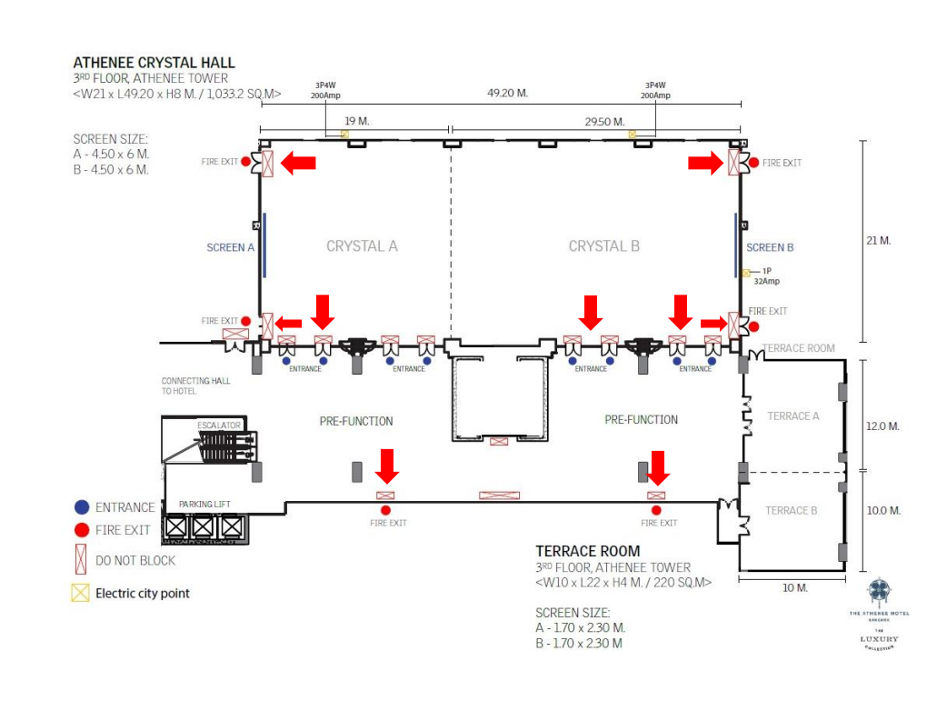
Crystal Hall on 3rd floor, Athenee Tower

Slide 4
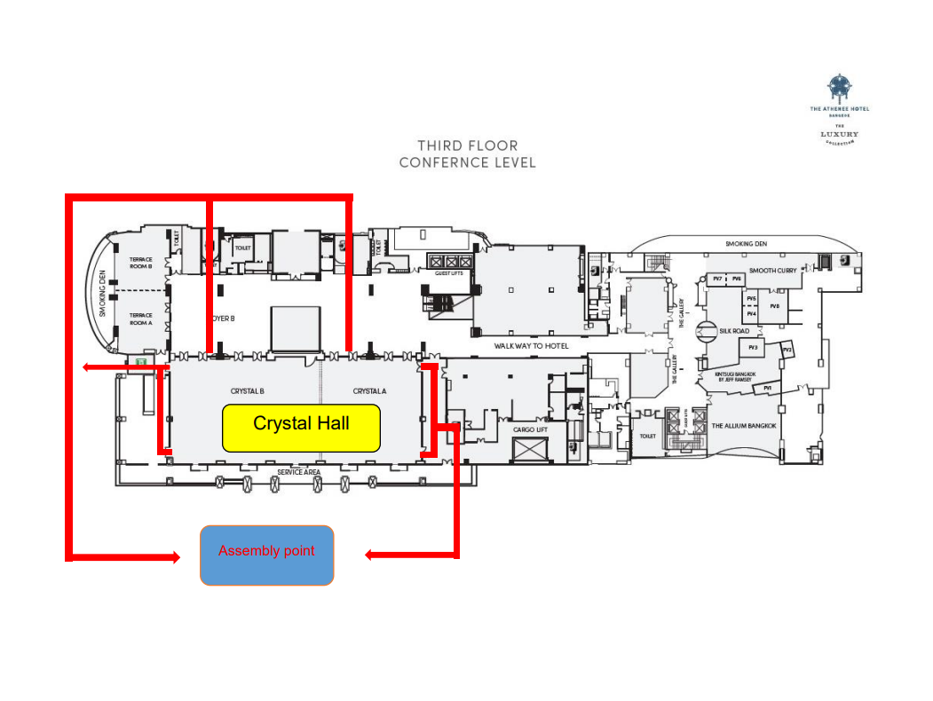
Crystal Hall on 3rd floor, Athenee Tower

Slide 5
Grand Hall is located on the second floor of hotel building
In case of emergency, the bell alarm will be rang and public address will be announced to evacuate.
There are total 4 exit doors with exit sign in the room
After the guest evacuate from the hall, they can use the staircase on the left or right to go down to the hotel lobby and evacuate from the building by main door.
Then the guest has to turn right to hotel assembly point where it is in front of Athenee Tower (The building is next to hotel building)
If you have any question or any concern about safety and security, please contact our service associate.

Slide 6
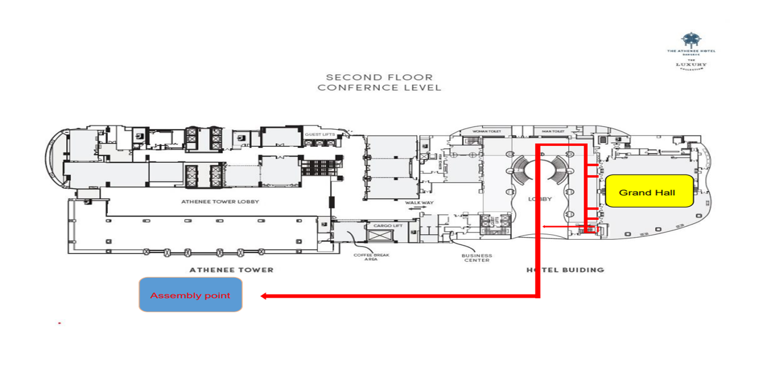
Grand Hall, 2nd floor, The Athenee Hotel

Slide 7
London, Japan and China room are located on the second floor of Athenee Tower building
When the guest hear the bell alarm and announcement, please evacuate from the hall immediately.
There is exit doors with exit sign to show in each function room
After the guest evacuate from the room, they can use the escalator go down to Athenee Tower lobby and evacuate from the building by the Athenee Tower lobby door.
The assembly point is in front of the Athenee Tower building.
If you have any question or any concern about safety and security, please contact our service associate.

Slide 8
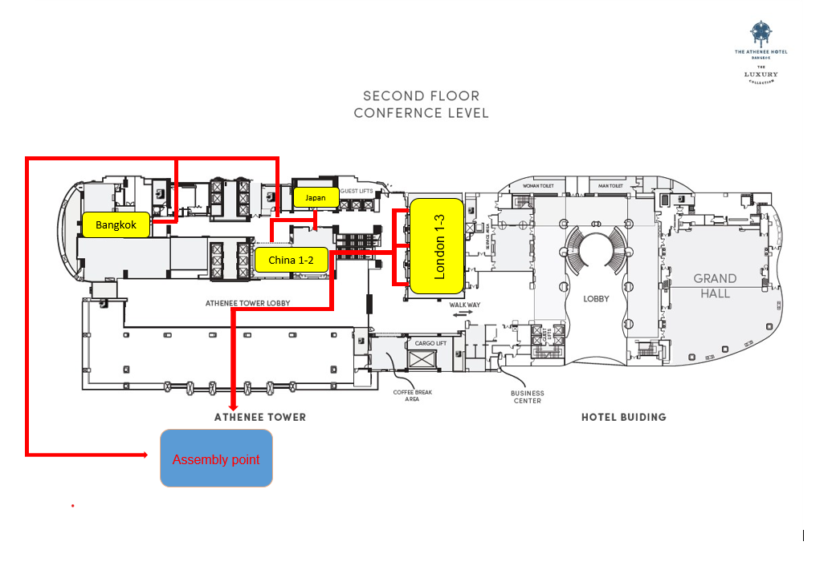
Function room on 2nd floor, Athenee Tower side

Slide 9
Kandhavas Place is located on the 4th floor of hotel building.
In case of emergency, the bell alarm will be rang and public address will be announced to evacuate.
There are total 2 exit doors with exit sign in the function room
After the guest evacuate from the function room, the guest can use the fire staircase on the left or right to go down to ground floor outside the hotel building.
Then the guest has to turn right to hotel assembly where it is in front of the Athenee Tower (The building is next to the hotel building)
If you have any question or any concern about safety and security, please contact our service associate.

Slide 10
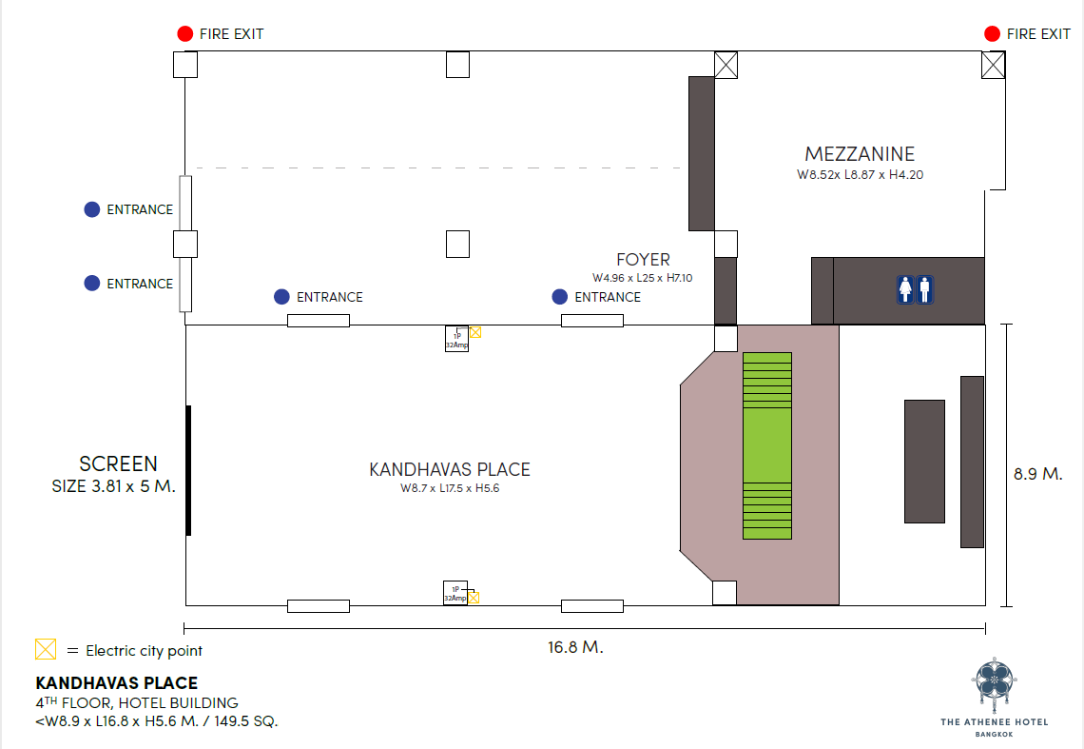

Kandhavas Place, 4th floor, The Athenee Hotel
VIP Myanmar
vvipo

Slide 11
All Athenuem meeting rooms are located on 6th floor of hotel building
In case of emergency, the bell alarm will be rang and public address will be announced to evacuate.
There are total 2 exit doors with exit sign at the end of left and right side of corridor for evacuation
Every fire exit doors will lead the guest to go down to ground floor outside the hotel building
Then the guest has to turn right to hotel assembly point where it is in front of Athenee Tower (The building is next to hotel building)
If you have any question or any concern about safety and security, please contact our service associate.

Slide 12
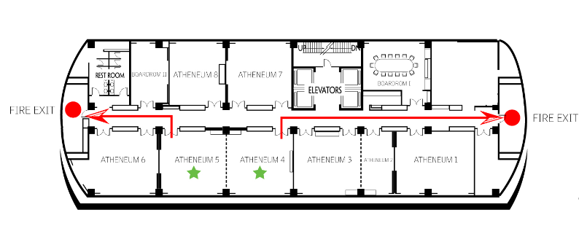
Atheneum meting rooms on 6th floor, The Athenee Hotel
Atheneum 3-4
Atheneum 5
Atheneum 1-2
Atheneum Lounge
Boardroom
Atheneum 6

Slide 13
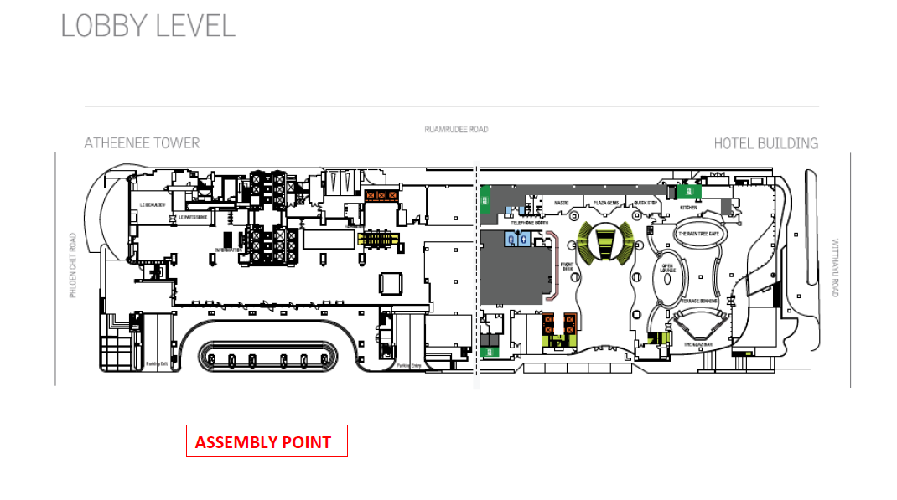
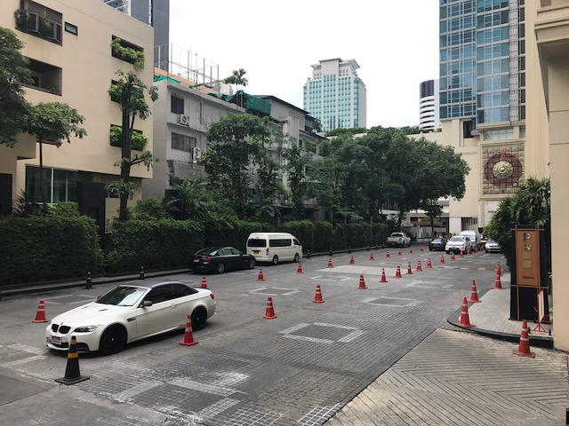
Main Assembly Point

